Slide 1
The U.S. Legal System & Food Regulations
John Khouryieh, PhD
Food Laws & Regulations
Western Kentucky University

Slide 2
Definitions: Act and Law
Act
a bill approved by both houses of congress and signed into law by the president.
Law
an act of congress that has been signed by the president.

Slide 3
Definitions: Statue and Code
Statue
federal or state written and enacted rules and administrative codes having the force of law.
Code
legal term for collection of statutes and rules.

Slide 4
Definitions: Regulation
Regulation
Administrative code or rule issued by the governmental agencies; regulations are implemented to enforce statutes.
Federal regulations are first published in the Federal Register and later codified in the Code of Federal Regulations.

Slide 5
Definitions: Rule
Rule
Applies to more restricted or more specific laws than statutes.
“ Rule ” often is an abbreviated form of the term “ administrative rule, ” which is a law promulgated by an administrative agency. Administrative rules are also called regulations.
Some administrative orders, resolutions, and formal opinions are also “ rules. ”

Slide 6
Definitions: Guideline and Ordinance
Guideline
suggests something advisory rather than binding.
Ordinance
applies to an order enforced by a local unit of government, such as a city.

Slide 7
The System of U.S. Laws can be Divided into Four Parts
Constitution
Statutes
Regulations
Common law and case law

Slide 8
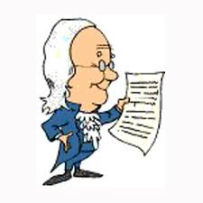
Constitution
Provides the framework for the U.S. legal system.
Both empowers and limits government.
Creates the federal government.

Slide 9
Constitution Divides the Power among the 3 Branches:
The legislative power - U.S. Congress (Article I)
The executive power – U.S. President (Article II)
The judicial power - U.S. Supreme Court

Slide 10
Statutes
Within their power granted by the U.S. and state constitutions, respectively, Congress and state legislatures enact public acts, also called statutes.
All statutes must be consistent with the U.S. Constitution.
State and local laws must also be consistent with the applicable state constitution.

Slide 11
The Regulations
Regulations are promulgated by federal agencies to implement and interpret the laws that are passed by Congress.
New regulations are first published in the Federal Register and then codified in the Code of Federal Regulations (CFR).

Slide 12
Case Law and Common Law
Both are based on judicial decisions.
Case law is the law established by the precedents of judicial decisions in cases (as distinguished from laws created by legislatures).
Common law is the body of law based on legal tradition, custom, and general principles. Common law is embodied in case law and that serves as precedent or is applied to situations not covered by statute.

Slide 13
Federalism
The Constitution divides the power of government vertically between federal and state governments.
Federalism is the term used to refer to this division of power.
Federalism also limits the ability of a state to interfere or burden other states.
The federal laws preempt state and local laws if they conflict.

Slide 14
How Are Regulations Made?
After a bill becomes a law, the agency or department is responsible for enforcing the statute by making rules and regulations.
1- When a regulation is proposed by a agency it is then published in the Federal Register.
2. There is a comment period during which people can write in with opinions and criticisms.

Slide 15
How Are Regulations Made? (Cont’d)
3. The regulation is printed in the Federal Register as a final rule.
4. Final rules are codified in the Code of Federal Regulations (CFR).

Slide 16
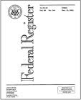
Federal Register
Official daily publication for rules, proposed rules, and notices of Federal agencies and organizations, as well as executive orders and other presidential documents.
Published by the office of the Federal Register, National Archives and Records Administration (NARA).

Slide 17
Federal Register (cont’d)
By law, anyone can participate in the rule-making process by commenting in writing on rules FDA proposes.
To learn more about this process, read Making Your Voice Heard at FDA website.

Slide 18
Code of Federal Regulations (CFR)
A yearly codification of general and permanent rules published in the Federal Register by executive departments and agencies such as Department of Health and Human Services (HHS) and the Department of Agriculture.

Slide 19
CFR Titles
Divided into 50 titles
Titles 7, 9, and 21 contain most of the laws regulating foods
Title 5 Governmental organizations and employees
Title 7 Agriculture
Title 9 Animal and animal products
Title 15 Commerce and trade

Slide 20

CFR Titles (cont’d)
Title 16 Conservation
Title 19 Customs
Title 21 Food and drugs
Title 27 Alcohol, tobacco products, and firearms
Title 42 Public health and welfare
Title 49 Transportation

Slide 21
Each Title is Divided into:
Chapters
Parts
Subparts
Sections

Slide 22
Example of CFR Title
TITLE 21-Food and drugs CHAPTER I-Food and Drug Administration Department of Health and Human Services SUBCHAPTER B-Food for Human Consumption (continued)
PART 170-Food Additives
Subpart B-Food Additive Safety
Sec. 170.38-Determination of food additive status

Slide 23
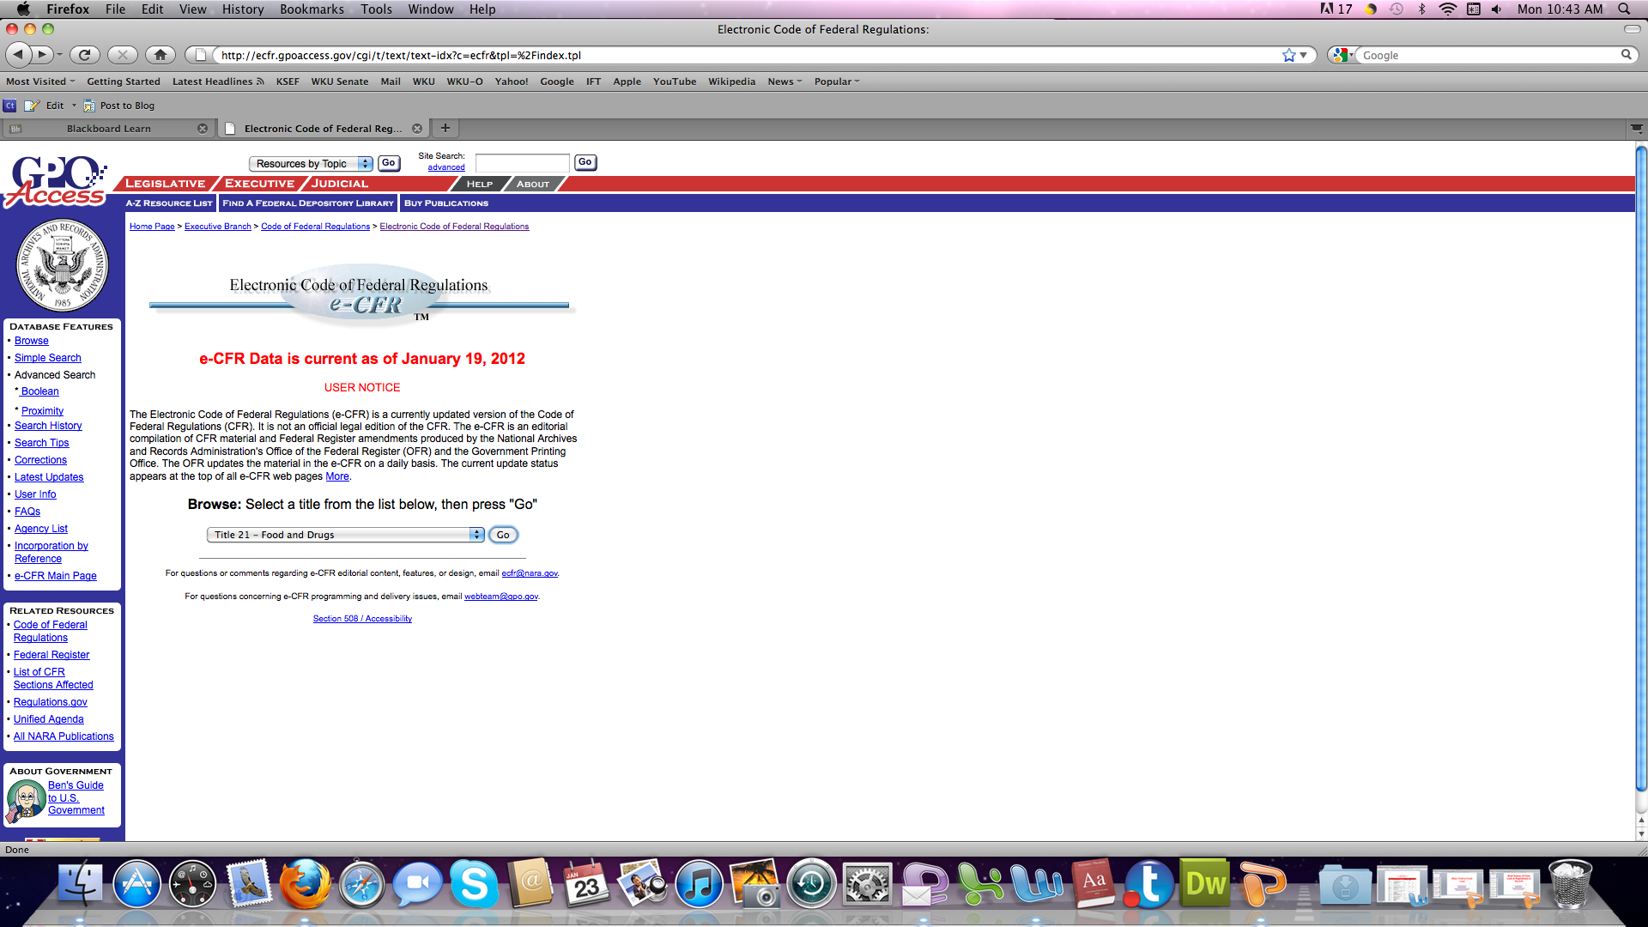
Electronic Code of Federal Regulations (e-CFR)

Slide 24
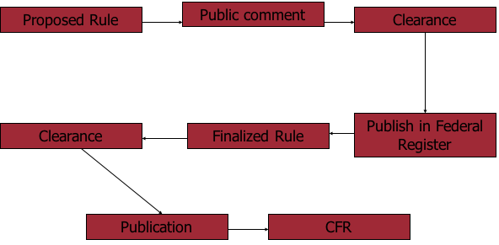
The Life Cycle of a New Rule

Slide 25
Where to Find Legal Information
The federal government makes legal information available at the federal libraries and on the internet.
Information on the Internet can be accessed from the U.S. Government Printing Office’s GPO Access site.

Slide 26
Where to Find Legal Information (Cont’d)
U.S. Code
The U.S. Code is the codification by subject matter of the general and permanent laws of the U.S. based on what is printed in the Statutes at Large.
It is divided by broad subjects into 50 titles.
These titles are Not the same titles as those in the CFR.

Slide 27
Useful Websites
U.S. Food and Drug Administration (FDA)
Electronic Code of Federal Regulations (e-CFR)

